Slide 1

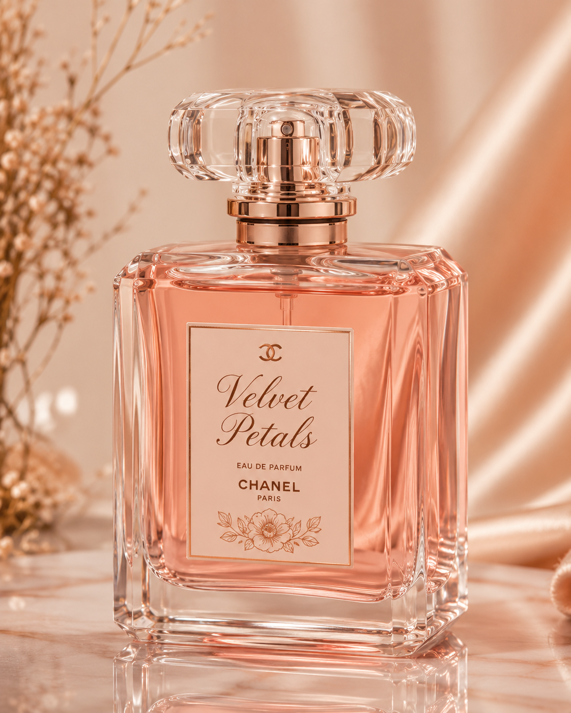
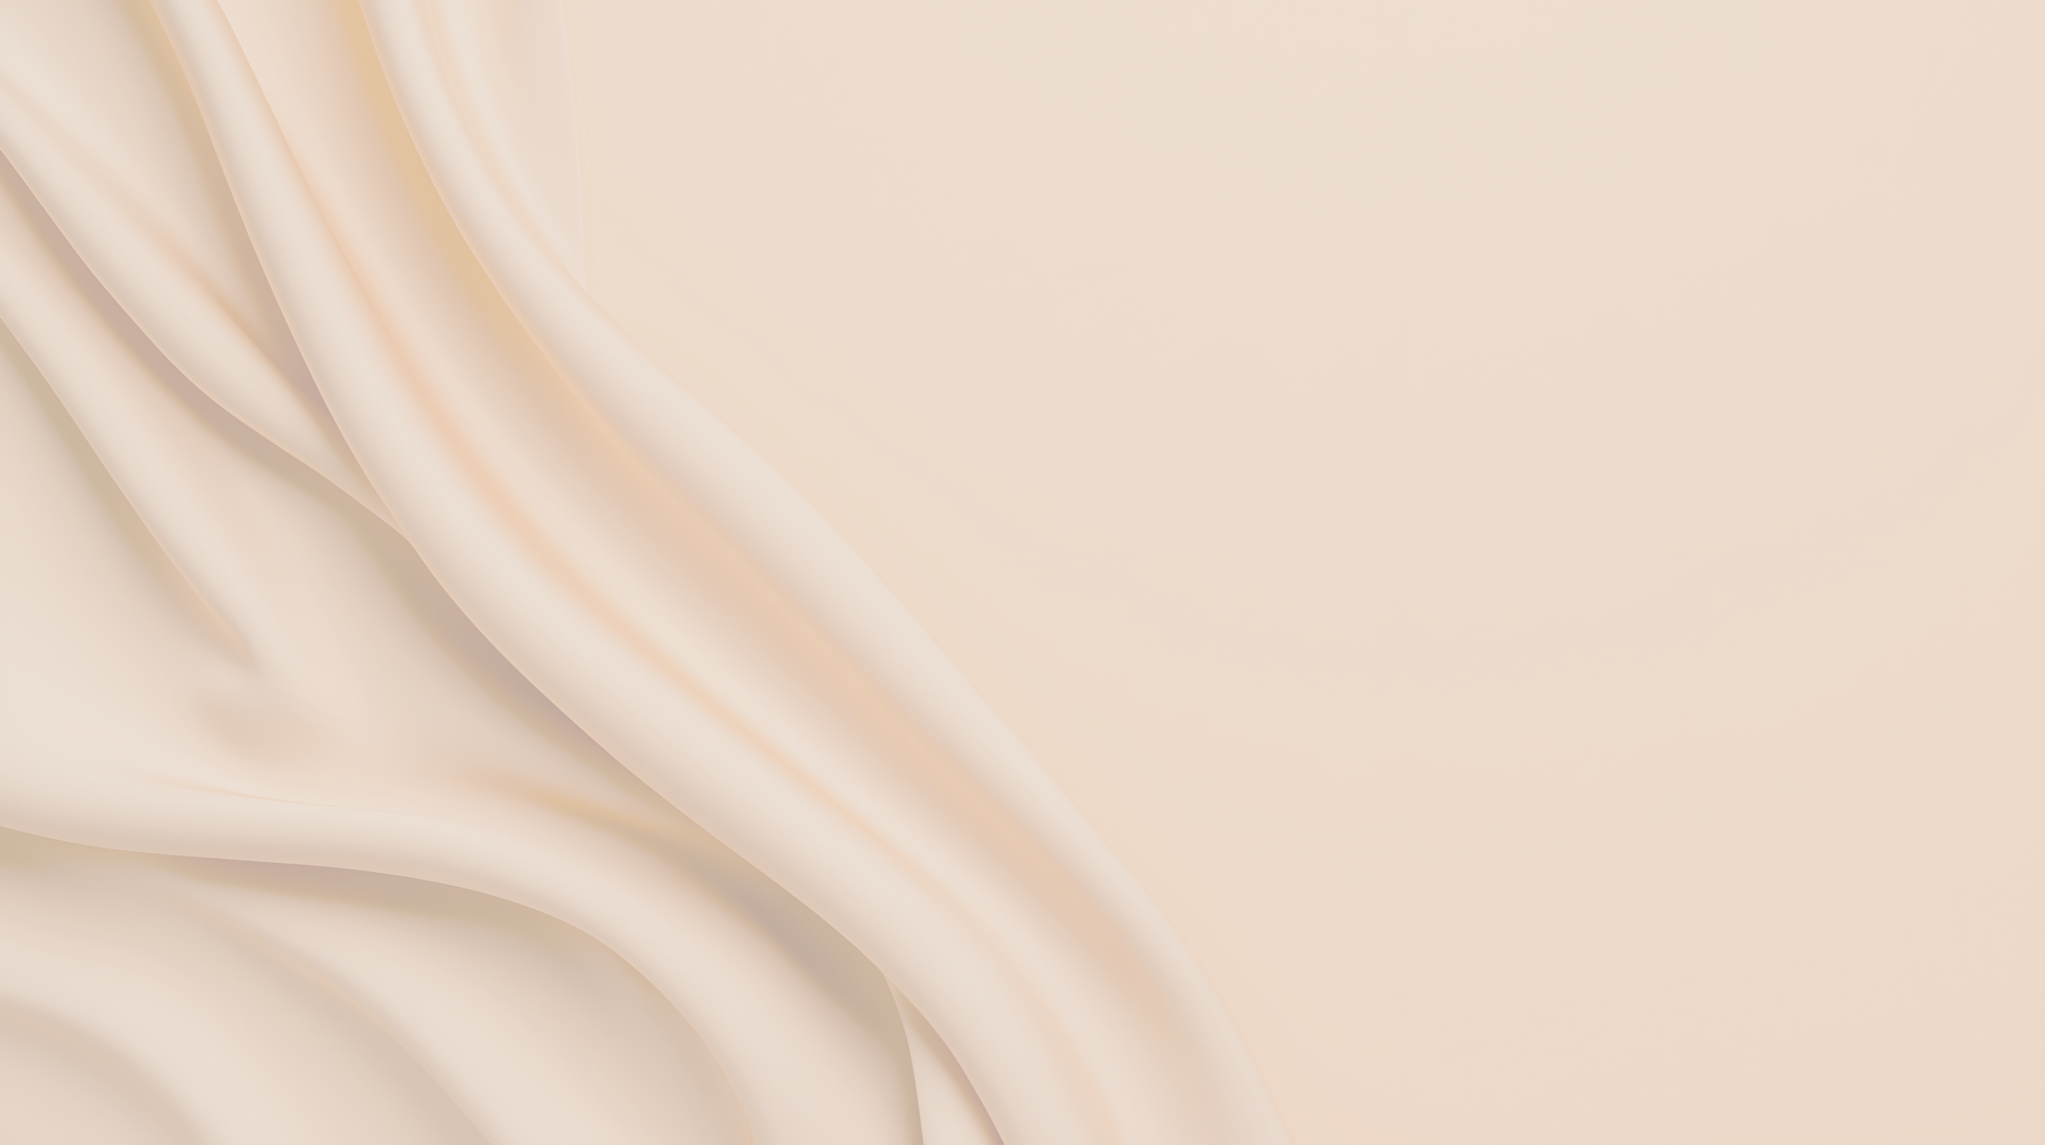



Chanel
Velvet
petals
Creating Scents That Inspire
www.chanel.com

Slide 2
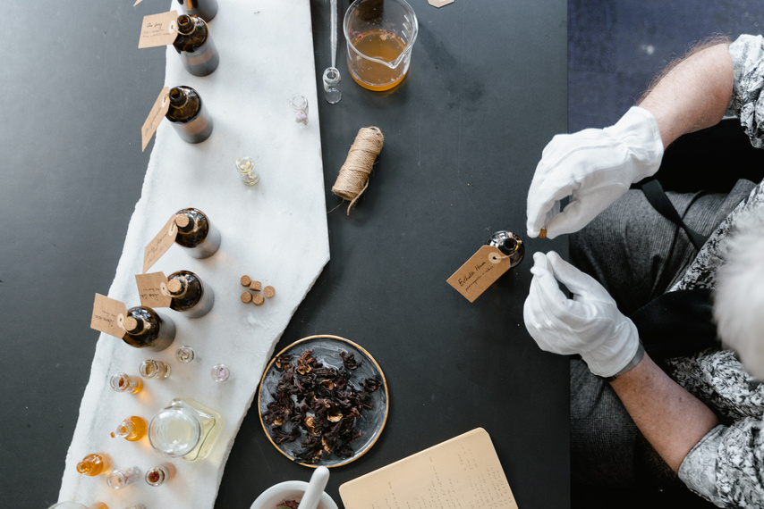
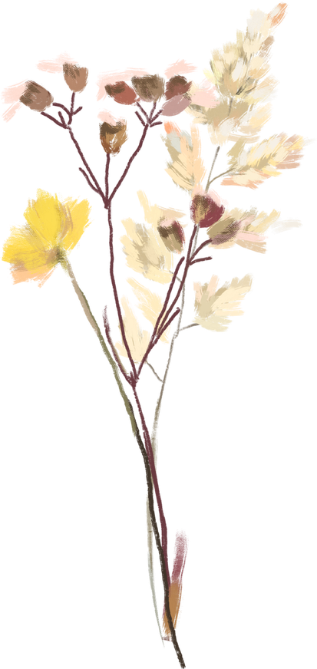
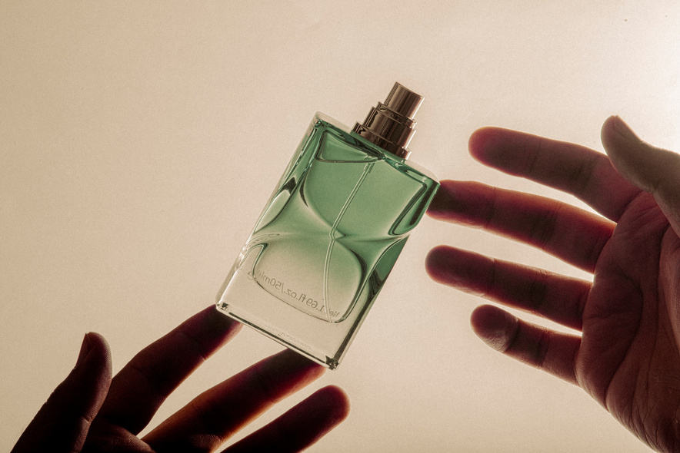
Company Overview
Velvet Petals is a modern perfume brand that creates soft, elegant, and long-lasting fragrances. Our products are designed to give confidence, freshness, and luxury in everyday life. We focus on quality ingredients, beautiful packaging, and unique floral scents that suit every personality.

Slide 3
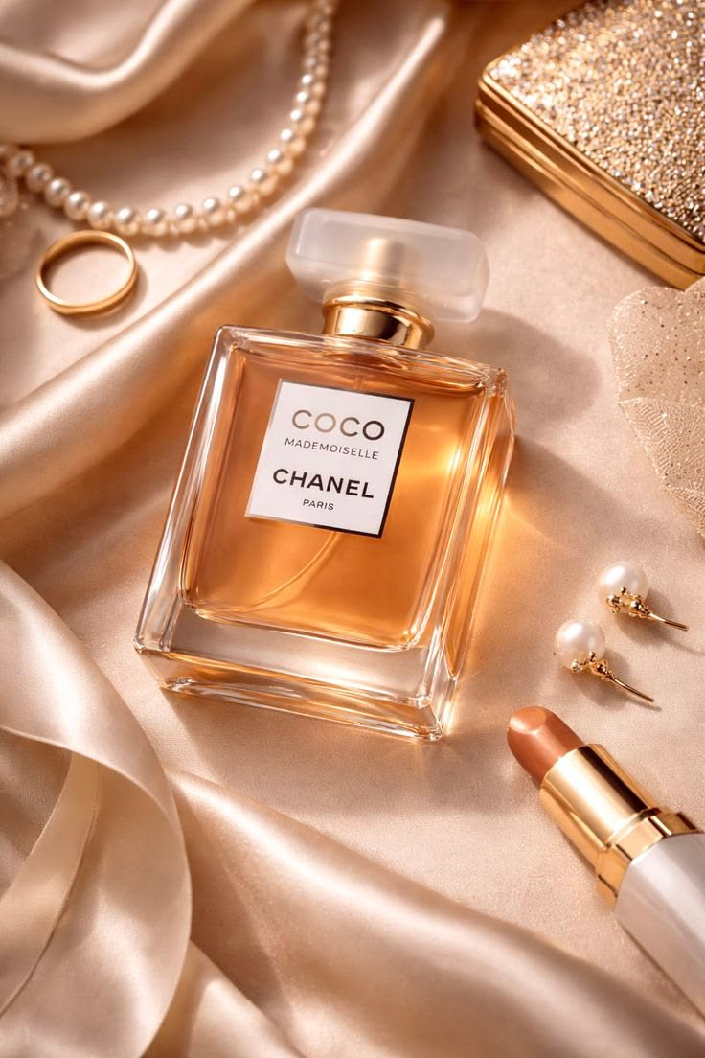


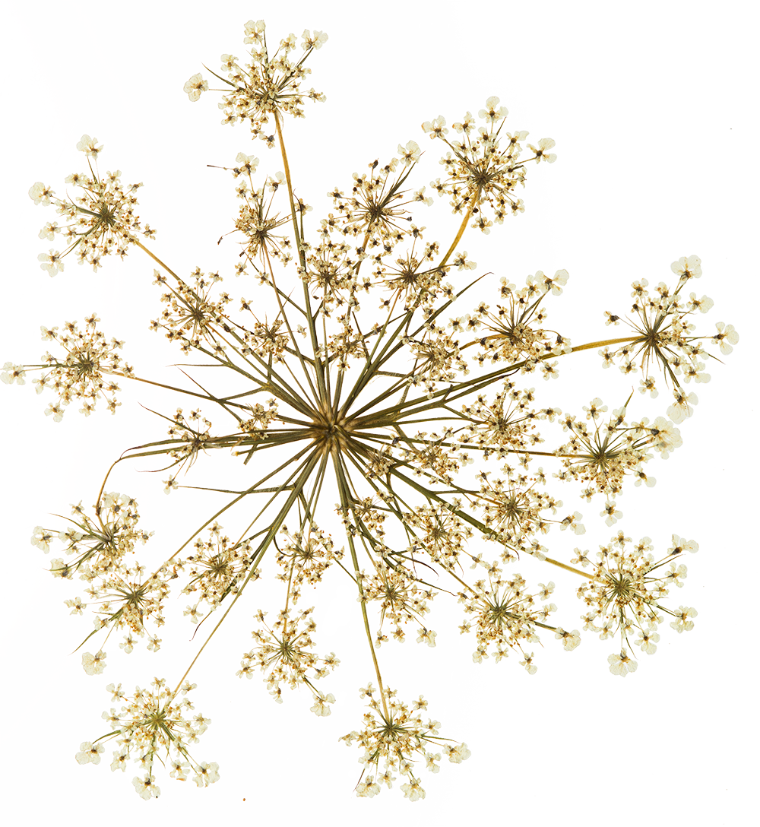
The Problem
Consumers face limited options for truly distinctive fragrances.
Growing demand for sustainable and eco-conscious products.
Generic scents dominate mass-market offerings.

Slide 4
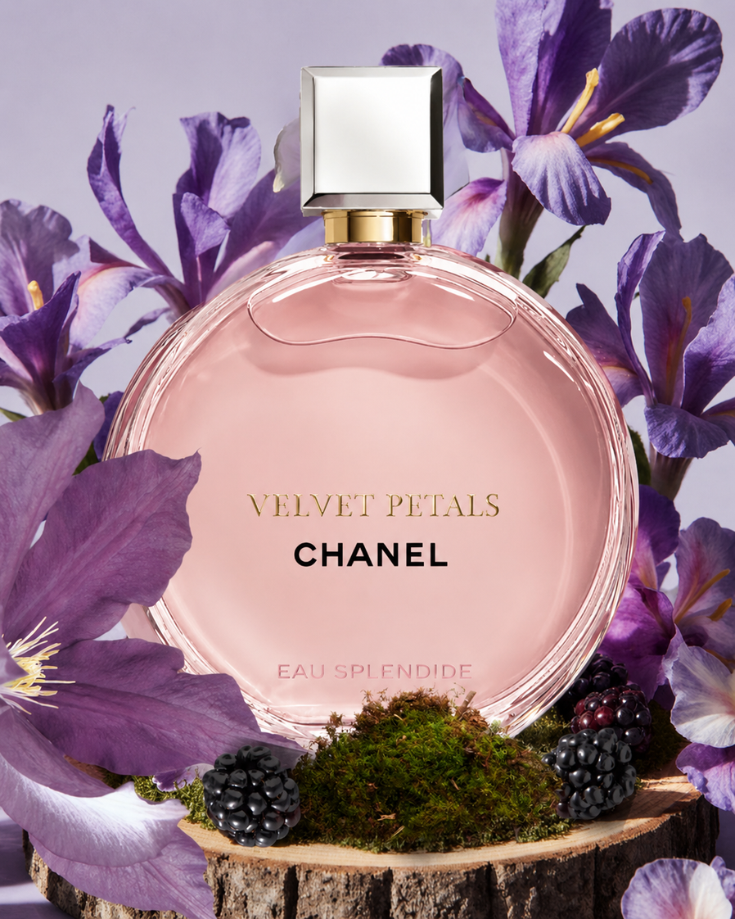
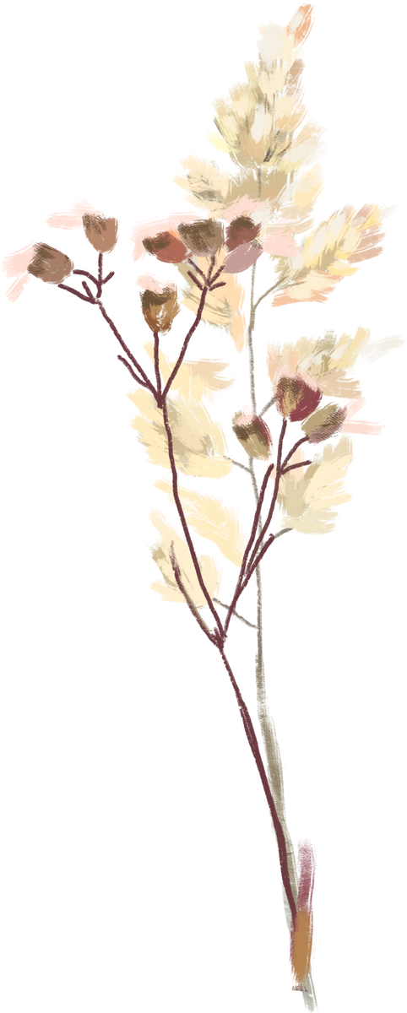

Our Vision
We envision a world where perfumes are more than just fragrances —
To become a trusted perfume brand that inspires confidence, elegance, and freshness through unique and long-lasting fragrances for everyone.

Slide 5
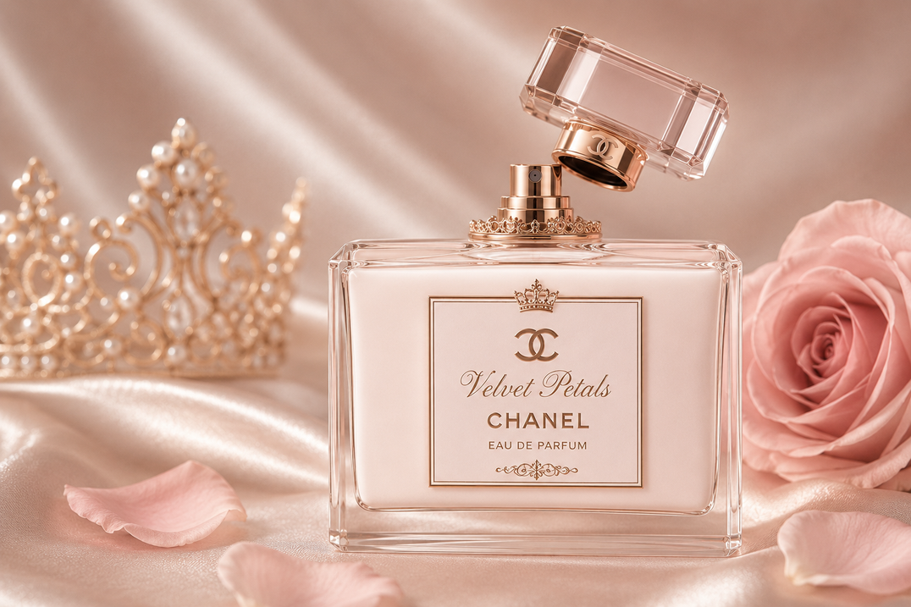
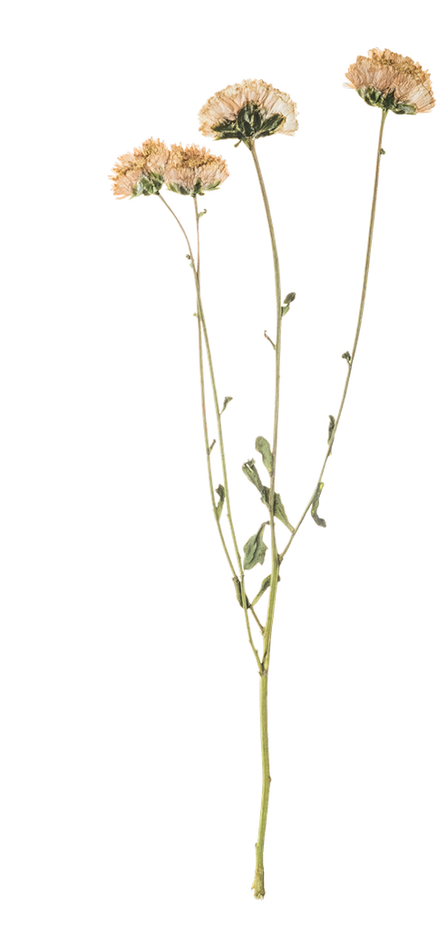

Core Offerings
Exclusive Perfume Collections with unique, lasting notes.
Custom Fragrance Development for clients seeking tailored scents.
Sustainable Sourcing using ethically harvested ingredients.
Premium Quality Control ensuring top-tier production.

Slide 6
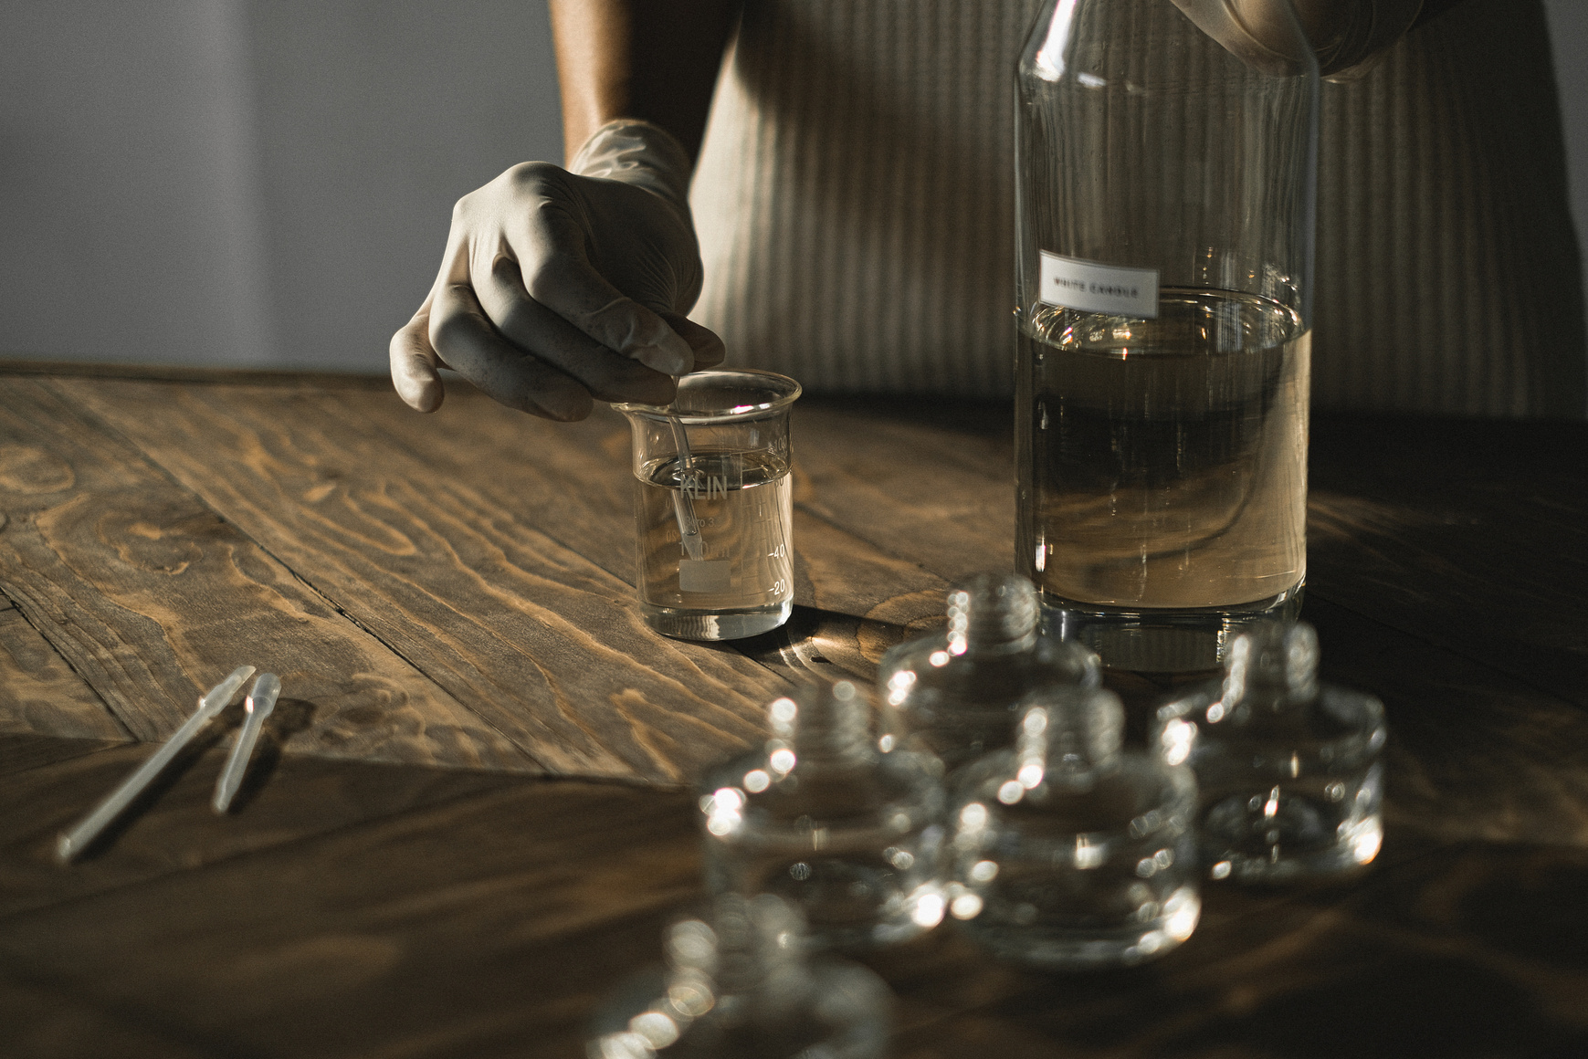

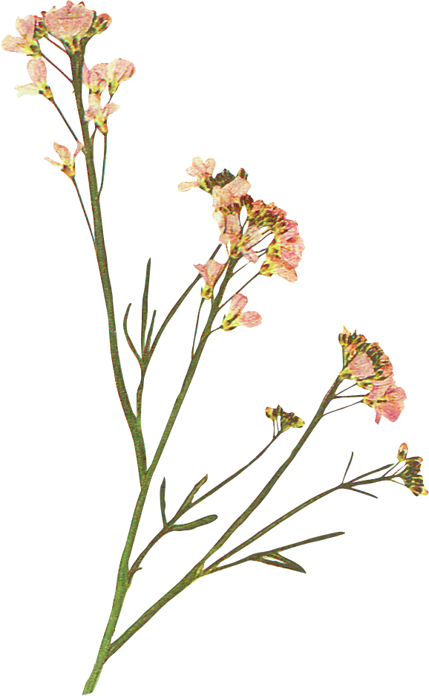
• Growing demand for luxury and floral perfumes.
• Young customers prefer stylish fragrance brands.
• Online shopping increases perfume sales worldwide.
• Affordable premium perfumes attract more buyers.
Market Potential

Slide 7
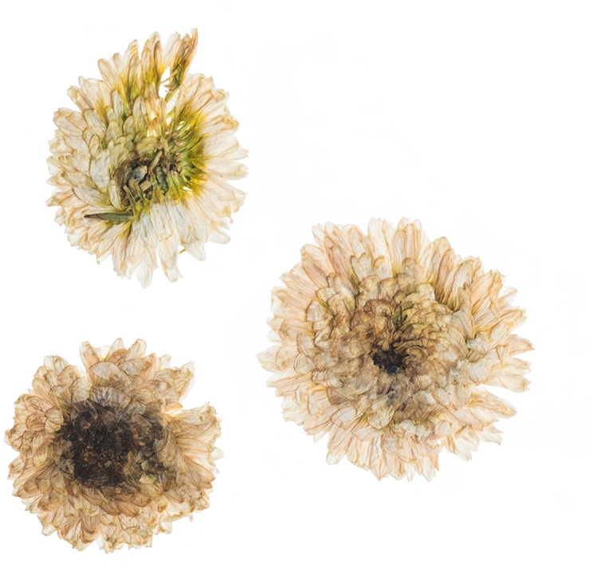
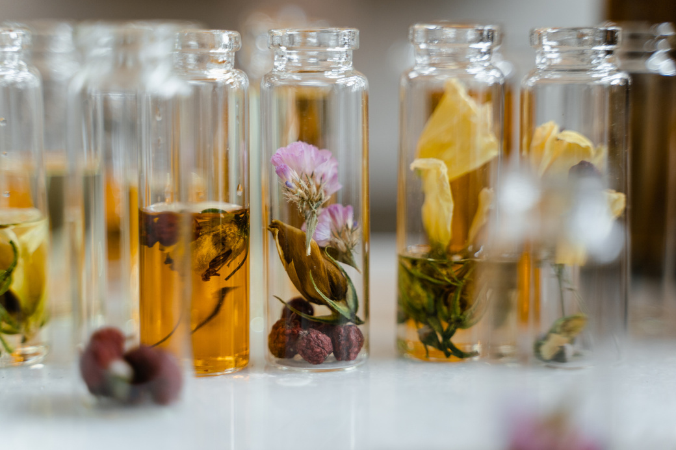
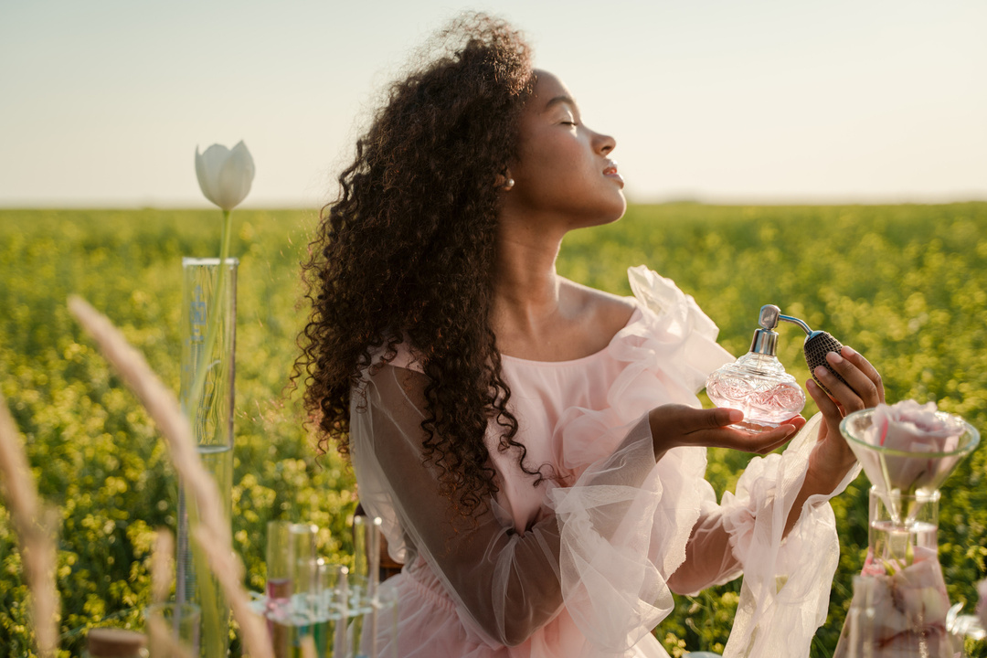

Business Strategy
Strategic online campaigns to reach wider audiences.
Collaborations with luxury retailers and lifestyle brands.
Bespoke fragrance creation for niche markets.

Slide 8
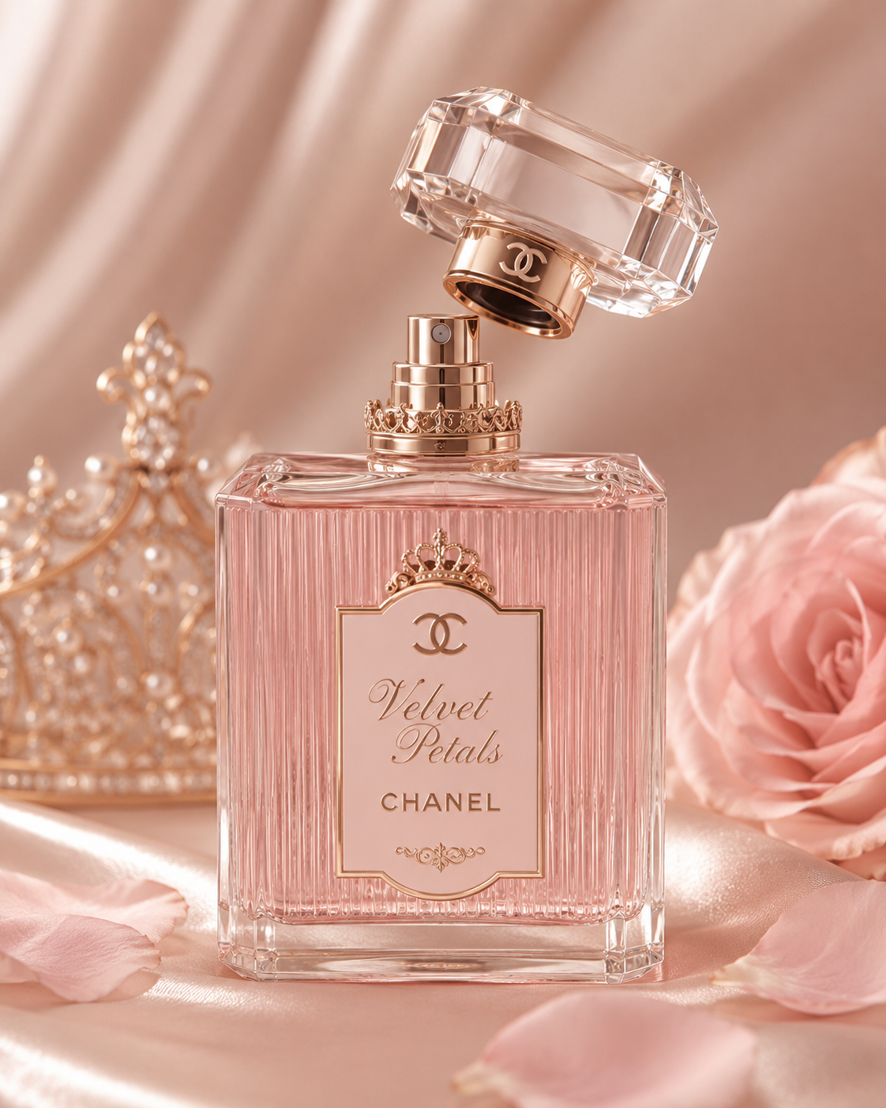
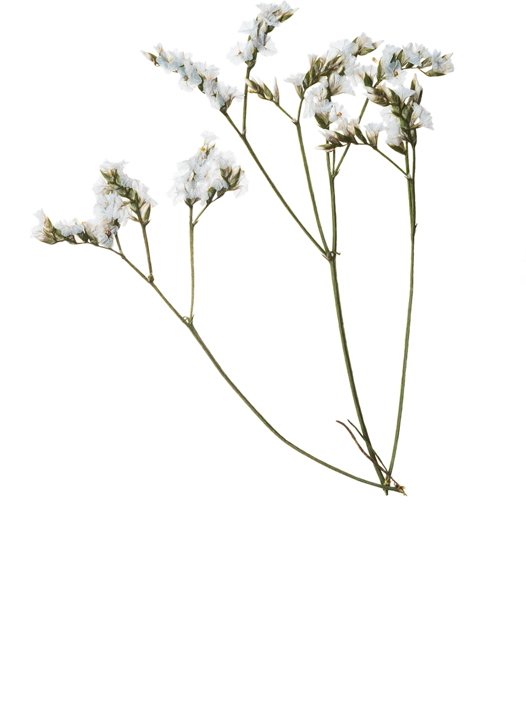
Competitive Advantage
Our strength lies in combining innovative scent design with ethical production practices. Ingoude Company bridges the gap between creativity and sustainability, setting new standards for authenticity and environmental responsibility.

Slide 9
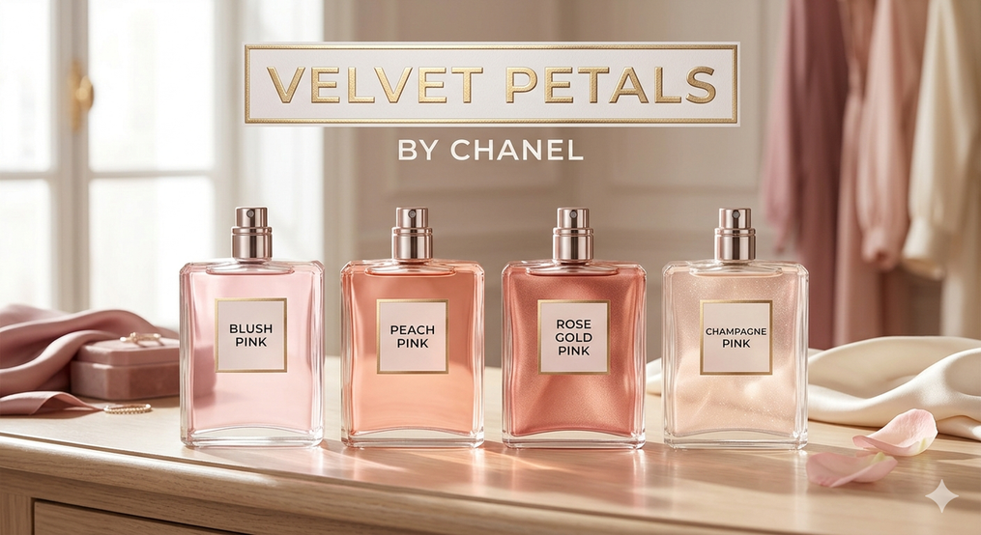
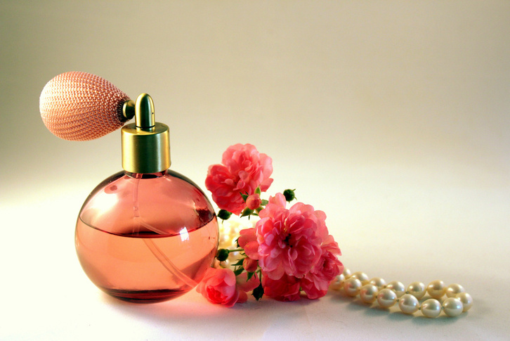

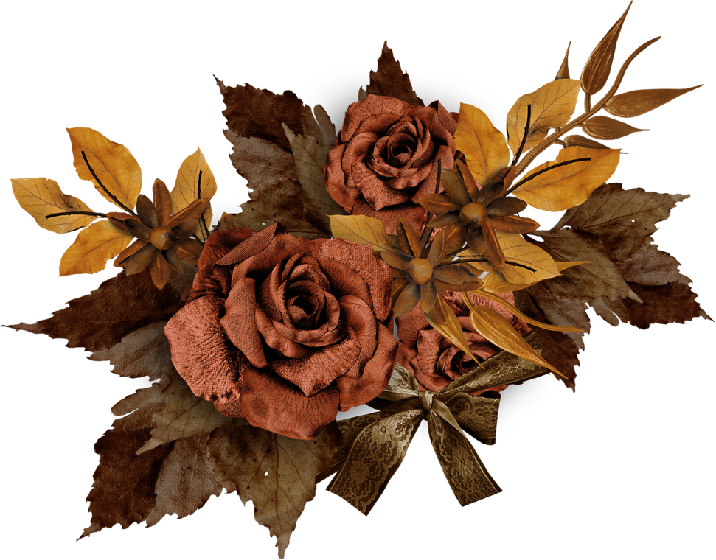
Growth Plans
Launch personalized fragrance kits for global markets.
Expand into premium lifestyle collaborations.
Invest in advanced scent technology and R&D.
Build immersive consumer experiences through digital platforms.

Slide 10
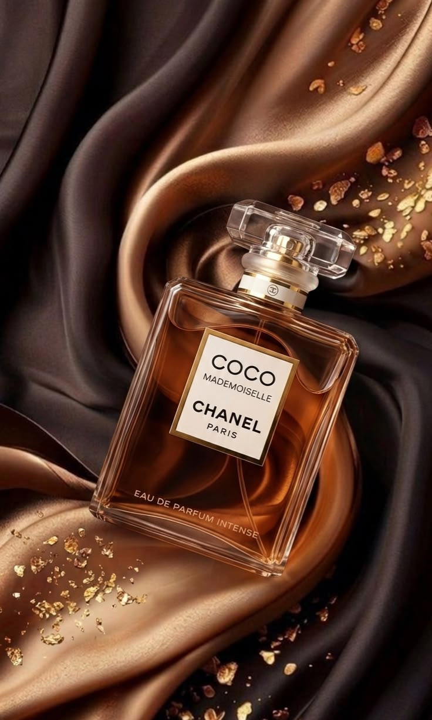
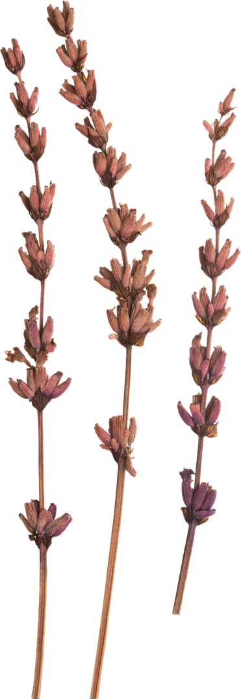
Final Statement
Velvet Petals aims to bring elegance, freshness, and confidence through unique perfumes. With quality products, stylish packaging, and customer satisfaction, our brand is growing towards a successful future.

Slide 11
THANK
YOU

